Slide 1
DETECTING INSURANCE CLAIMS FRAUD USING MACHINE LEARNING TECHNIQUES
TEAM DETAILS:
SAI SPANDANA ECHAMBADI(20EG105142)
KODIDALA KOUSHIK KUMAR(20EG105125)
SHEIK MOHAMMED KAIF(20EG105145)
MARRI NITHIN REDDY(20EG105153)
PROJECT SUPERVISOR
Mr.D. Ramana Kumar
Assistant Professor

Slide 2
Introduction
When an insurance firm, agent, adjuster, or customer intentionally lies to get an unfair advantage, then insurance fraud occurs. It can happen when purchasing, utilizing, reselling, or underwriting insurance. Insurance fraud can be classified into various subcategories, including fraud committed by consumers and insurance firms. Fraud affects consumers and businesses financially, in addition to adding to insurance companies’ costs.
Fraud detection is the process of identifying fraudulent activities or attempts. It is important to have a detection system in place to prevent fraud from happening and to protect businesses and consumers from the financial losses that can result from these activities.
Applications:
Workers’ Compensation Benefit fraud
Auto insurance fraud
Disability and healthcare fraud
Benefits:
Proactive fraud detection
Faster fraud detection
Accurate fraud detection
Lesser human interventions
Cost savings

Slide 3
Problem Statement
Fraud in insurance is done by intentional deception or misrepresentation for gaining shabby benefit in the form of showing false expenditures and claim. Data mining tools and techniques can be used to detect fraud in large sets of insurance claim data.
To detect Fraud Insurance Claims using machine learning with some effective parameters.

Slide 4
Objective
To detect the auto\vehicle fraud by using, machine learning technique along with the performance will be compared by calculation of confusion matrix which can help to calculate accuracy, precision, and recall.
Existing Model:
There are various AI methods with which frauds can be detected.
• To classify, combine cluster data, and segment, using data mining that can find rules in data and be able to highlight specific patterns, including those related to fraud.
• Professional programs to detect fraud in the form of laws.
• To automatize determining factors of false claims, ML techniques are employed

Slide 5
Proposed Method
We have a set of rules and anomalies for the creation of the raw data. The rules and anomalies are depended upon a specific set of attributes. This paper focuses on fraud claims of auto/vehicle-related to insurance. The raw data consists of details of the policy and claims. The raw data is transformed into a dataset and is fed into the classification algorithms like logistic Regression and random forest. The transformed data set contains of different sets of attributes. By using these attributes, we can check every detail regarded to the claim. In case of normal claims, the gap claim occurrence date and claim report date is less than seven days, where the whole document is submitted with proof. In case the gap between policy effective date and claim occurrence date is less than five days, also check the claims on same vehicle during all policy periods.

Slide 6
Proposed Method
In case of Logistic Regression, just consider each attribute in each class separately and then train and test the data. The random forest algorithm helps us validate or predict the data. By using confusion matrix, we can calculate performance of each algorithm. Confusion matrix provides information on false positive (fp), false negative (fn), true positive (tp), true negative (tn) which is used for assessing the percentage of test data which has been correctly labelled by the classifier. With the help of this information, the accuracy, precision, and recall is calculated.

Slide 7
Experiment Environment
We used the following two coding environments:
1.Visual Code Studio
2.Jupyter Notebook

Slide 8
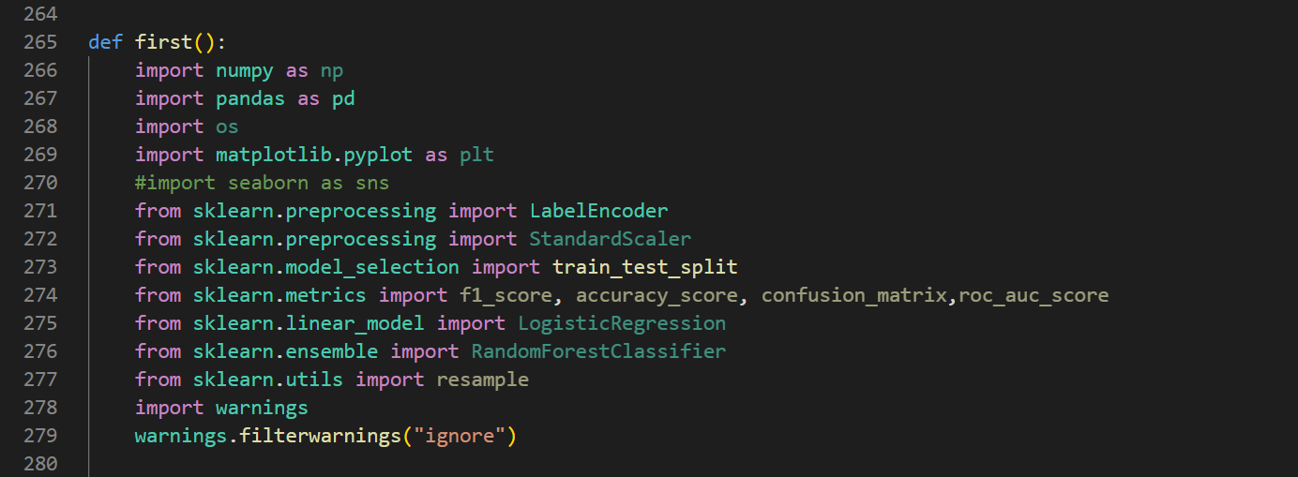
Experiment Screenshot
Libraries Imported

Slide 9
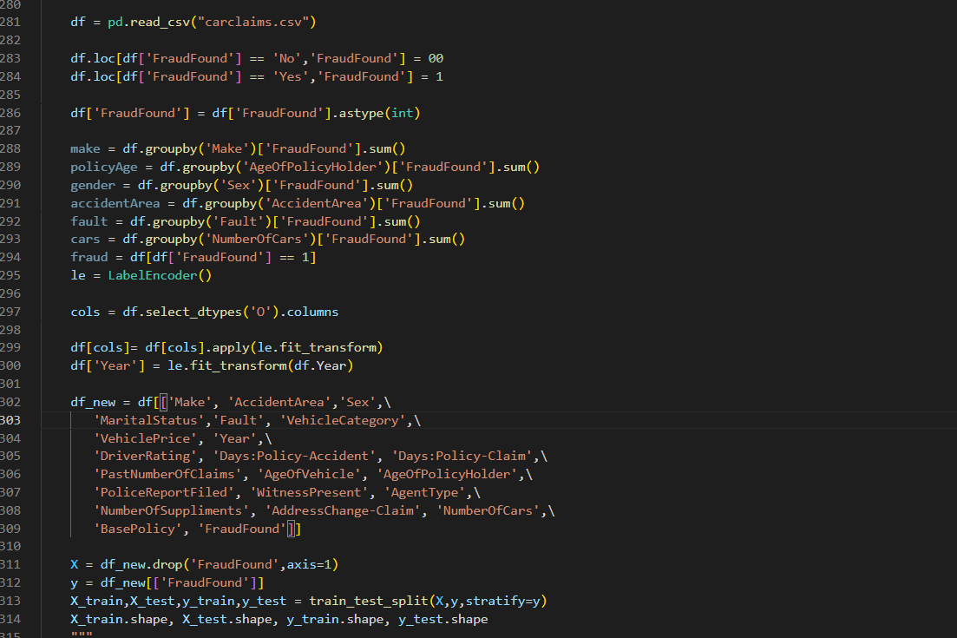
Data imported- Training the Data Model

Slide 10
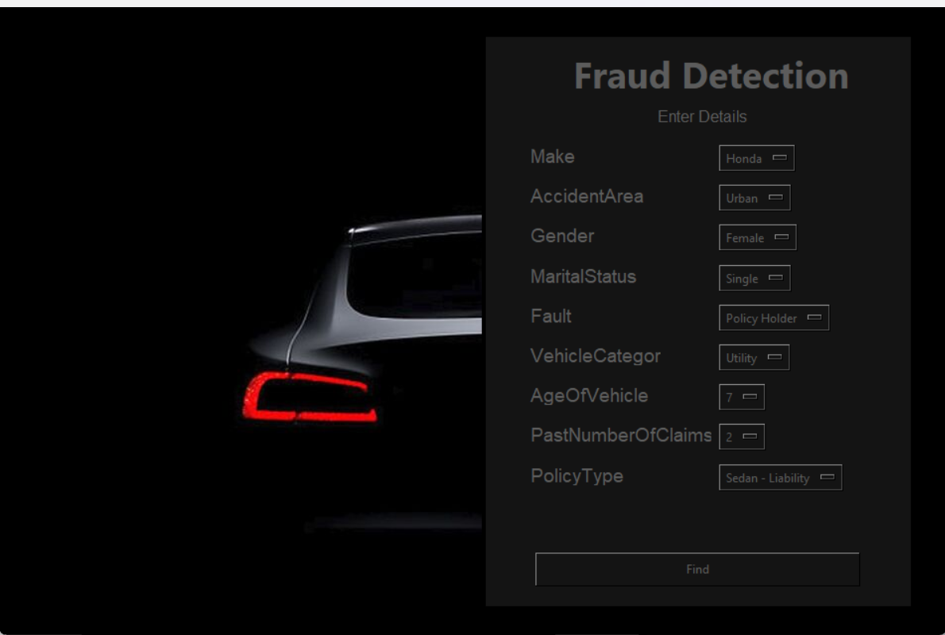
Interface Created

Slide 11
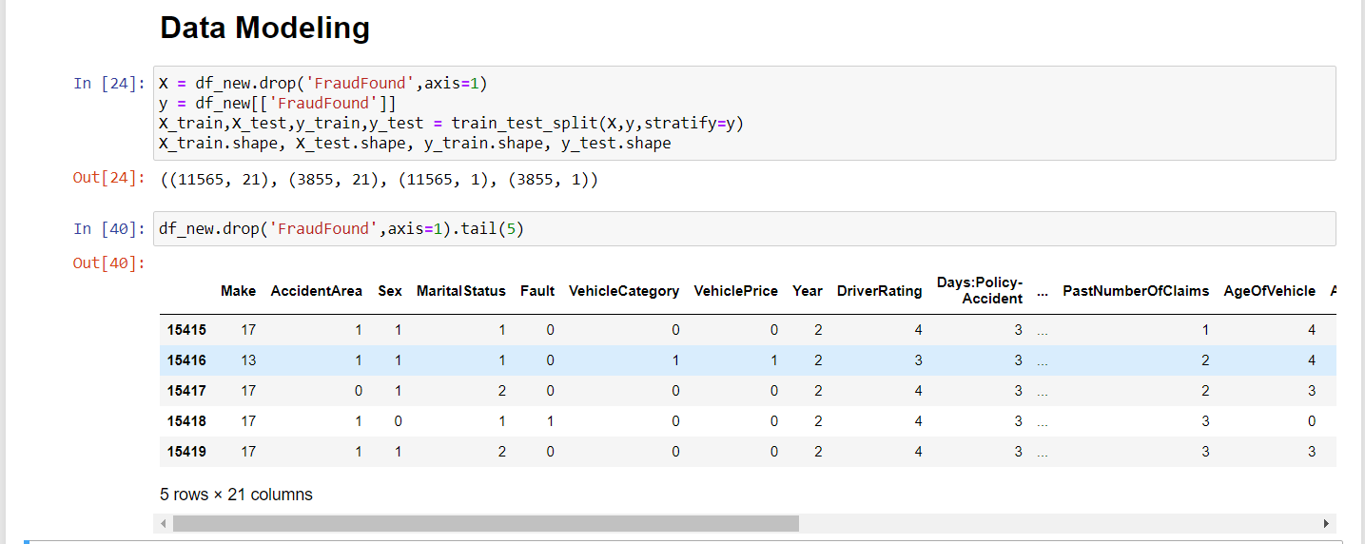
Data Modeling

Slide 12
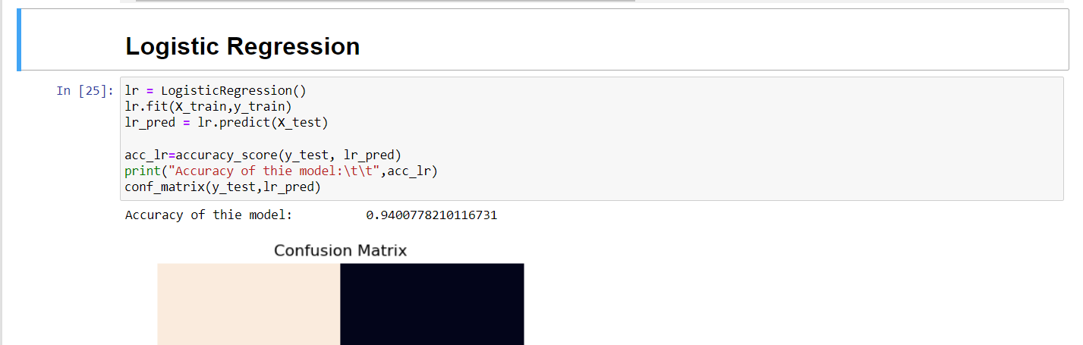
Data Modeling- using Logistic Regression

Slide 13
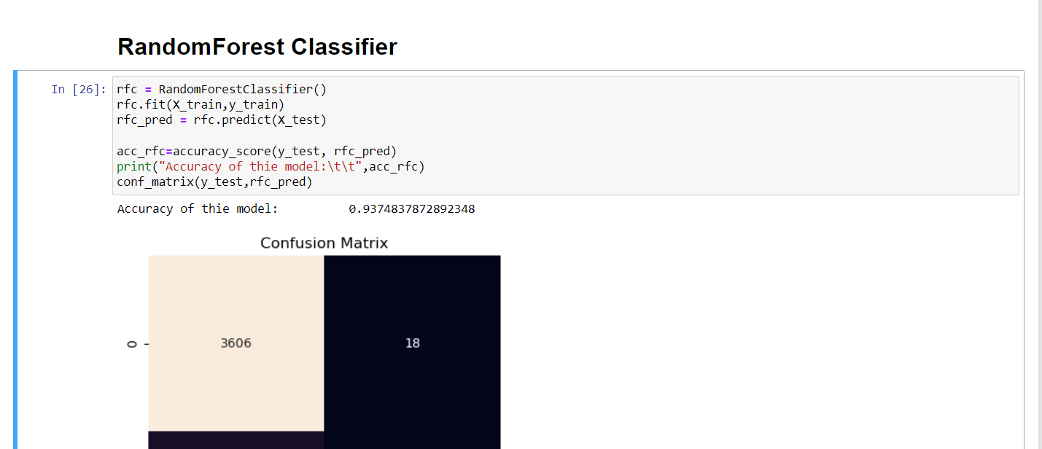
Data Modeling- using Random Forest Algorithm

Slide 14
Findings
1.The Accuracy of Logistic Regression in this model is: 0.9400778210116731
2.The Accuracy of Random Forest Classifier in this model is: 0.9374837872892348
The dataset is extremely imbalanced and will not give accurate information. This can be overcome by one of the two ways :
Upscale the Minority Class (FraudFound ==1) in this case
Downscale the Majority Class (FraudFound ==0) in this case
>> Upscaling and DownScaling the data

Slide 15
Findings
>> After Upscaling and DownScaling the data
s.no | Model | Accuracy Score
0 | Logistic Regression | 0.940078
1 | Upscale Logistic Regression | 0.740378
2 | Downscale Logistic Regression | 0.688312
3 | Random Forest Classifier | 0.937484
4 | Upscale Random Forest Classifier | 0.986343
5 | Downscale Random Forest Classifier | 0.742424
**Hence based on the accuracy values we will be implementing upscale RandomForest Classifier on the Data

Slide 16
Justification
This models helps us in finding whether a policyholders auto insurance claim is fraudulent or not. Initially, In this model we have used two algorithms: Logistic Regression and Random Forest Classifier where we compared the accuracy of the algorithms and based on the accuracy and precision of the data model we decided to use Random Forest Classifier as a suitable algorithm for the dataset “Carclaims.csv”. Post implementation and creation of the GUI, the execution process commenced where by entering the details of the user , on clicking “find”, it returns an output whether that user is fraudulent or not.
HENCE THE AIM OF THE PROBLEM IS SOLVED AND JUSTIFIED
Future trends: Increasing use of AI and Machine Learning in Fraud Detection .enhanced Data sharing among insurers for better detection.Leveraging block chain for secure and transparent claims processing.
Conclusion: Vehicle insurance claims fraud detection is an ongoing challenge for insurance industry .Employing a combination of data analytics ,AI and investigative method can help insurers mitigate losses and maintain trust of the policyholders.

